Slide 1






BASIC DETAILS OF THE TEAM AND PROBLEM STATEMENT
DOMAIN :AIML
PS CODE: AM-03
PROBLEM STATEMENT TITLE:ANIMAL TRACKING SYSTEM- PREDICTIVE ANIMAL LOCATION
TEAM NAME: SYNTAX SAGES
TEAM LEAD: ANIRUDH S ROTTI
TABLE CODE ASSIGNED: 1.3
INSTITUTE NAME:KLE INSTITUTE OF TECHNOLOGY – HUBLI-580025
HACKTOFUTURE-2024
IN ASSOCIATION WITH
THE INSTITUTION OF ENGINEERS (INDIA)
LOCAL CENTRE, BELAGAVI

Slide 2
LSTM MODEL
Using an LTSM model to predict the location,
1 D array input of Latitude , Longitude , Speed and Timestamps is converted into a 3 D array input , by using reshape.
80% of the values from the dataset were used to train the model and 20% of the values were used to test.
The prediction values constantly change in constant time intervals.
The prediction values are then displayed on the map

Slide 3
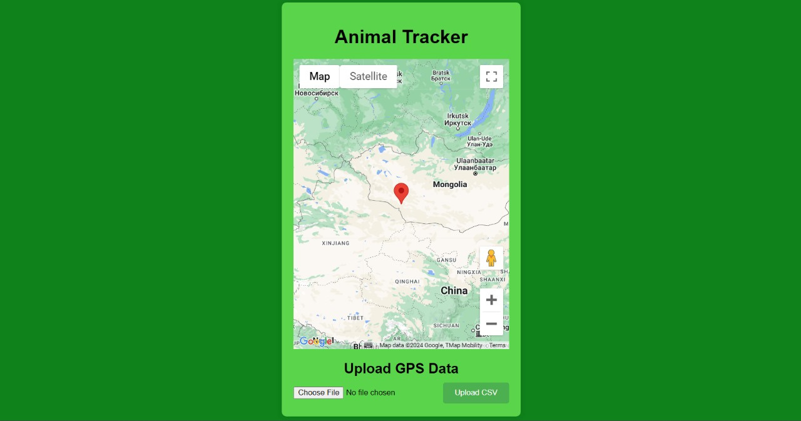
User Interface
To begin tracking the animal , user is supposed to a CSV file that has the animal tracking data.
UI features a interactive map , that uses Google’s API.

